Slide 1


IOT-BASED IRRIGATION SYSTEM
Experiment 4
Raphael S. Nano
CPE162P / C1
Computer Engineering Department
School of Electrical, Electronics, and Computer Engineering

Slide 2
Introduction: IoT-based Irrigation System
Soil quality is critical for plant health, and variables that increase soil quality include sunlight, nutrients, and moisture.
The soil's moisture content might vary depending on the plant. Some may require a lot of water, while others can thrive with little to none.
With the usage of IoT, a system for watering plants would be more convenient and efficient, with soil moisture detected in real time and visible to the user on another device

Slide 3
Objectives
To demonstrate how an IoT based irrigation system works.
To be able apply what were learned in logic circuits and switching theory, microprocessors, CPE160P, and CPE161P.
To be able to apply embedded systems with IoT using Arduino kit
To be able to use ThingSpeak for the data collection and analysis.

Slide 4
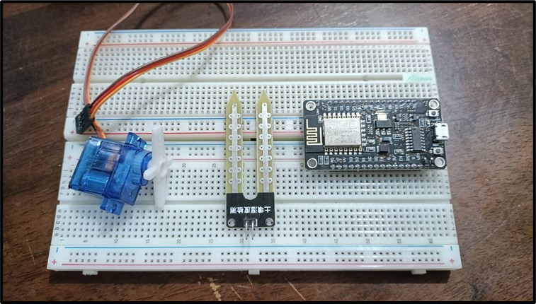
Materials
Hardware
ESP8266 WiFi Module
Soil Moisture Probe
LM393 Module
Liquid Crystal Display
SG90 Servo Motor

Slide 5
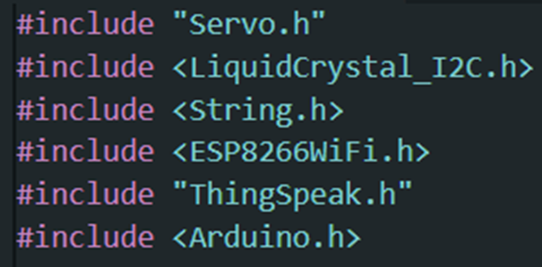
Materials
Software Libraries
ESP8266WiFi.h
ThingSpeak.h
Servo.h
LiquidCrystal_I2C.h

Slide 6
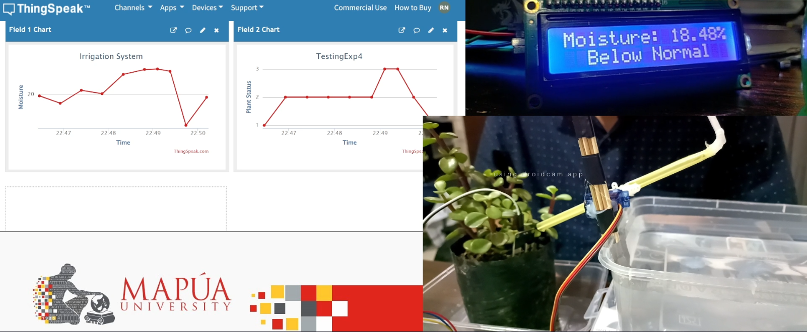
Discussion: IoT-based Irrigation System
Goal is to detect the change in moisture level in the soil and controls the flow of water accordingly with a motor.
ThingSpeak will also be utilized for data collection and analysis, including value graphing.

Slide 7
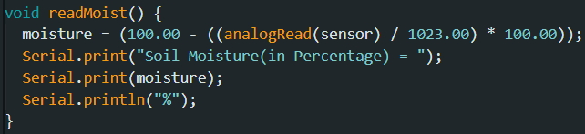
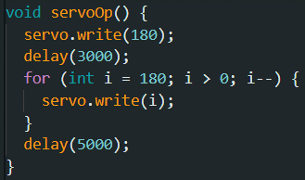
Discussion: IoT-based Irrigation System
Detection of soil moisture, displaying of values in the LCD, and rotation of servo motor to pour water
readMoist(): the DHT detects the temperature and humidity
lcd.print(): output the value of the moisture in the LCD
servoOp(): servo would scoop water and pour over the plant

Slide 8
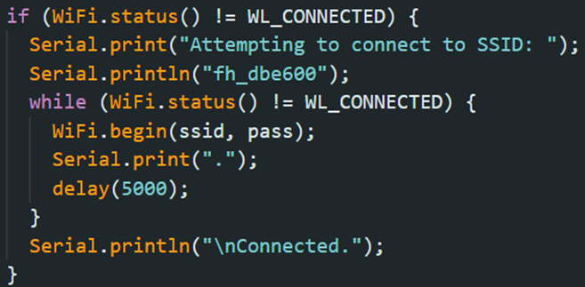
Discussion: IoT-based Irrigation System
The same code was utilized in establishing the Wi-Fi connection. It provides information to the user via the Serial Monitor, indicating the status of the connection attempt

Slide 9
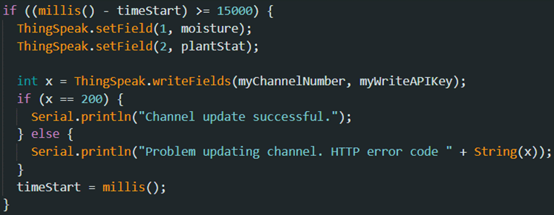
Discussion: IoT-based Irrigation System
ThingSpeak updates its fields every 15 seconds.
There are two fields: moisture percentage and plant status.
The values are updated using the ThingSpeak's writeFields() function.

Slide 10
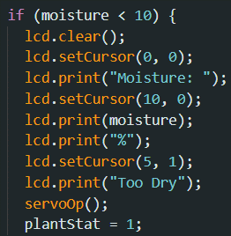
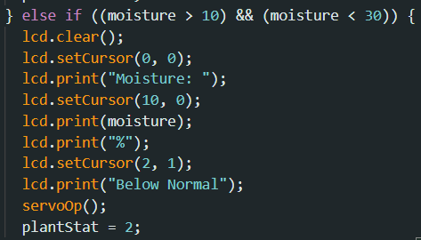
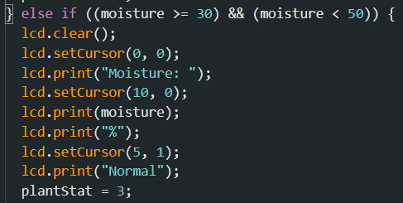
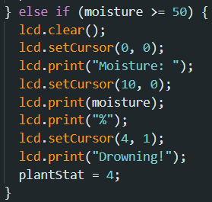
Discussion: IoT-based Irrigation System
Identification of the moisture percentage is every 3 seconds
4 Conditions: Too Dry, Below Normal, Normal, and Drowning
Too Dry: x < 10 %
Below Normal: 10% < x < 30%
Normal: 30% < x < 50%
Drowning: x > 50%

Slide 11
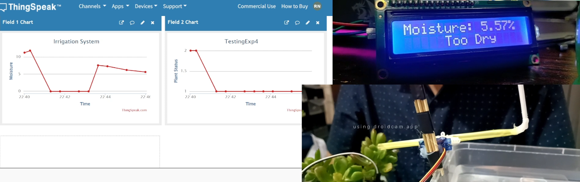
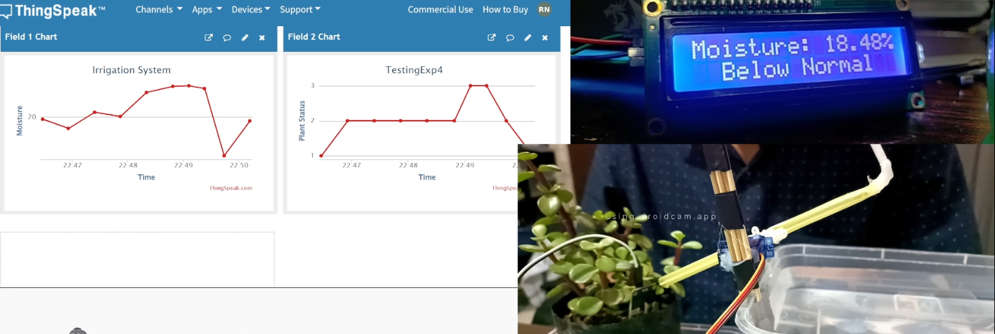
Results: IoT-based Irrigation System
Too Dry plant condition required a bit of time for it to be normal, requiring 4 servoOp() calls
Below Normal plant condition required 3 servoOp() calls

Slide 12
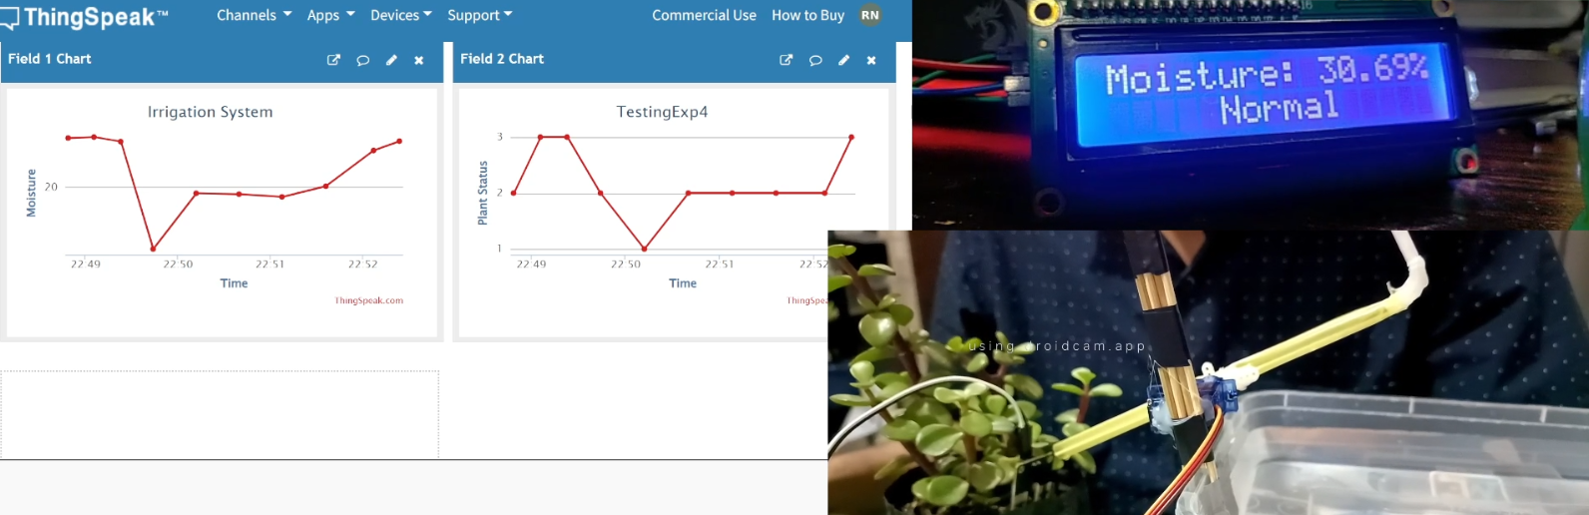
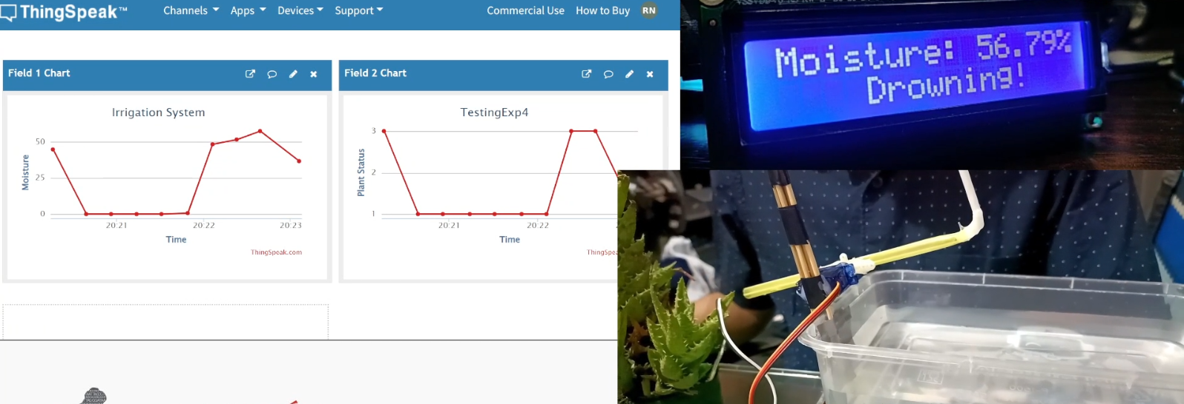
Results: IoT-based Irrigation System
Normal and Drowning conditions did not trigger the servo motor
All of the values were displayed in ThingSpeak and on the LCD

Slide 13
Conclusion
The IoT-based Irrigation System functions by:
  readMoist() for reading soil moisture
  lcd.print() to display moisture values in the LCD
  servoOp() to trigger the servo motor to scoop water
  Displays moisture value and plant status in ThingSpeak every 15 seconds

Slide 14
Conclusion
The second objective was achieved by:
  connecting the ESP8266 with ThingSpeak using Arduino IDE codes
  applying the LCD, soil moisture sensor, and servo motor libraries
The ThingSpeak effectively shows moisture percentage and plant status every 15 seconds, which was accomplished by utilizing the writeFields() function
The IoT-based Irrigation System was successfully developed, with accurate values and evident outputs in the servo motor, LCD, and ThingSpeak.

